Slide 1
Civic Engagement

Slide 2
Civic Engagement
Homework: Reflection on Civic Engagement
Describe the activity you conducted with the Germantown 8th graders.
How did you guide them in thinking scientifically (or not)?
What was good about the activity? How could the activity be improved?
What was surprising or challenging about being the teacher instead of the student?
Read the Bard Water Quality Report.
How is the activity you ran related to the information in this report? Think creatively.
What does the report tell you about the watershed you live in?

Slide 3
HIV: Follow-Up
Q: Can HIV-positive mothers transfer HIV antibodies to their HIV-negative babies?
A: Yes.
Antibodies typically do not cross the placenta, but they are found in breast milk.
However, breastfeeding carries the risk of transmission of HIV through blood. Why?

Slide 4
HIV: Dr. Agwu’s talk

Slide 5

HIV: Policy Case Study

Slide 6
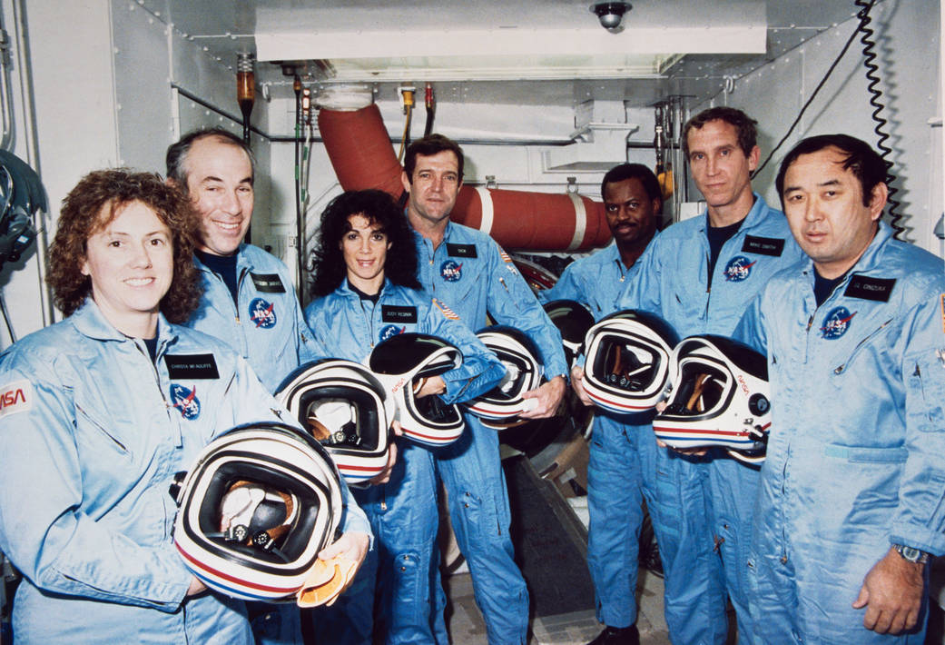
Space Shuttle Challenger
NASA’s second orbiting space craft
Launched on January 28, 1986
https://www.youtube.com/watch?v=fSTrmJtHLFU

Slide 7
Challenger: What happened?
Launch was rescheduled several times due to weather
Due to unusually cold temperatures, a teleconference occurred the night before the launch to discuss concern from engineers
Notes:
Information looked at by Challenger engineers
On an overhead projector

Slide 8
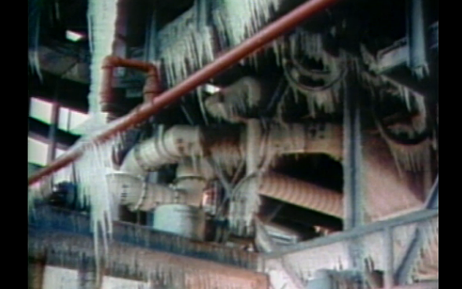
Notes:
Was 36oF out that day, ice covered the launch area
two rubber O-rings, which had been designed to separate the sections of the rocket booster, had failed due to cold temperatures on the morning of the launch.

Slide 9
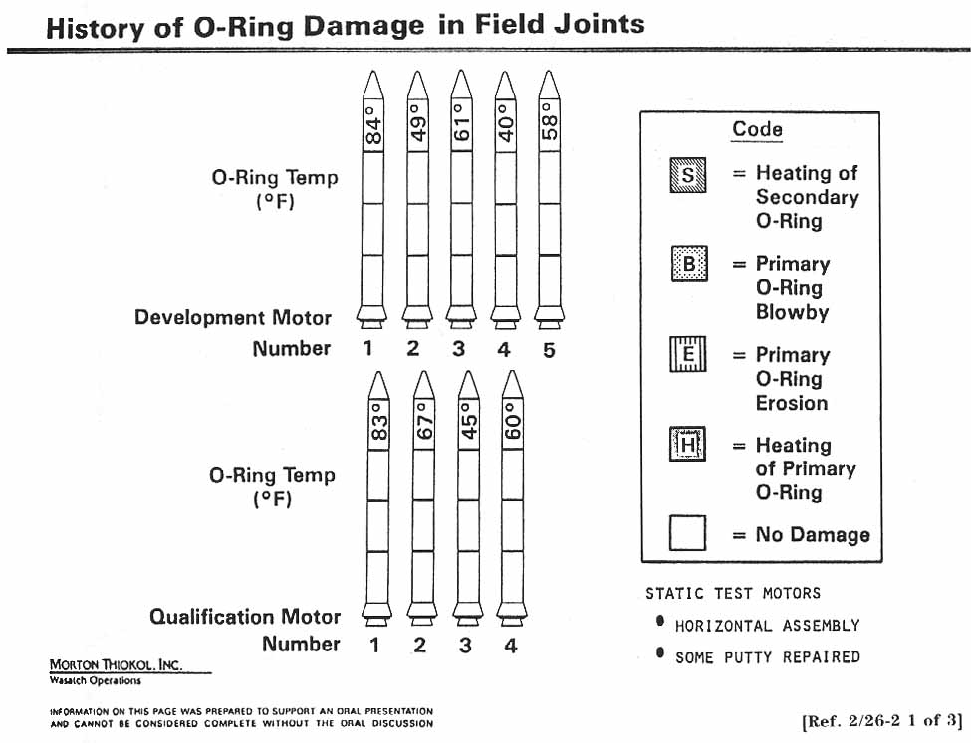
Report of the PRESIDENTIAL COMMISSION on the Space Shuttle Challenger Accident

Slide 10
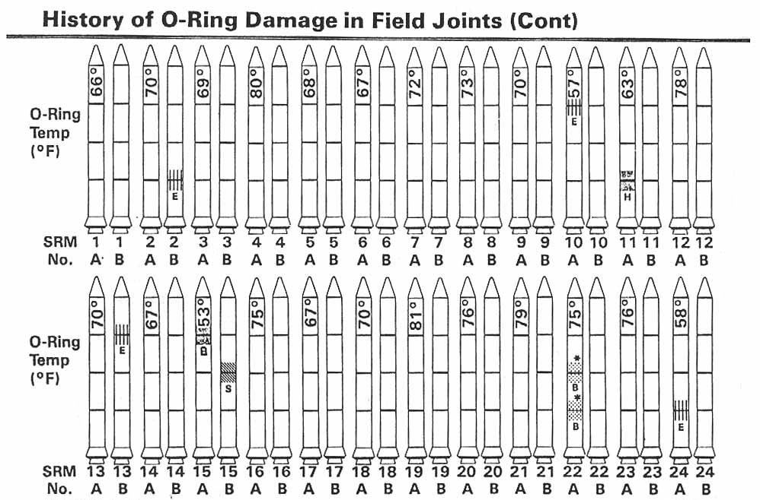
Report of the PRESIDENTIAL COMMISSION on the Space Shuttle Challenger Accident

Slide 11
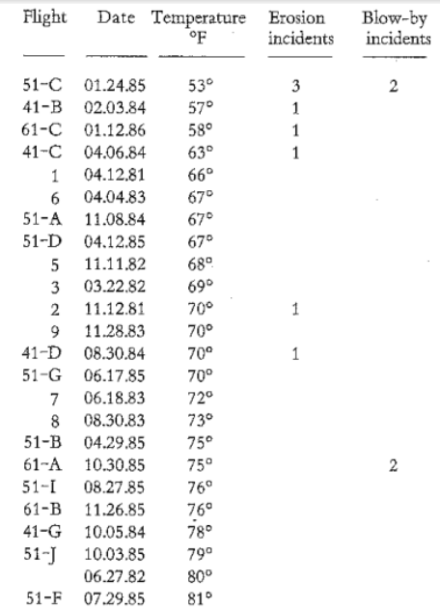

Slide 12
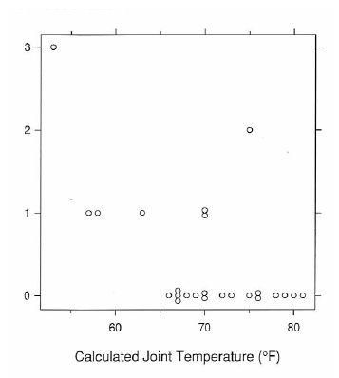
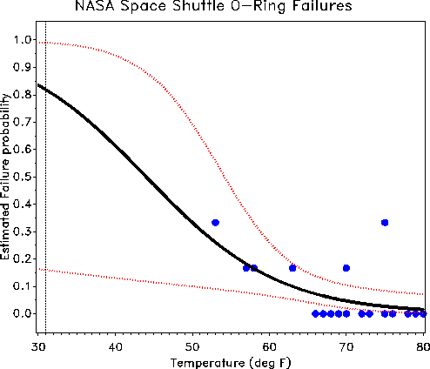
Number of failures

Slide 13
Discussion
What was informative about the original graphs? Your graphs?
What information was missing from the original graphs? Your graphs?
Could a different graph have changed the Challenger engineers’ minds about the launch? Why or why not?
Why is effective data visualization important?

Slide 14
Infectious Diseases
“Infectious diseases are caused by pathogenic microorganisms, such as bacteria, viruses, parasites or fungi; the diseases can be spread, directly or indirectly, from one person to another. Zoonotic diseases are infectious diseases of animals that can cause disease when transmitted to humans.” –World Health Organization (WHO)

Slide 15
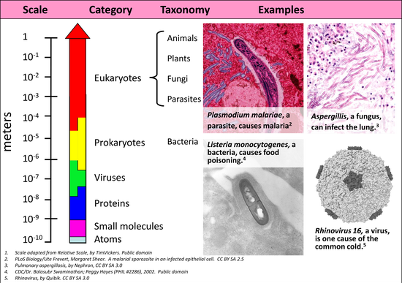
Notes:
Microorganisms can be classified into bacteria, viruses, fungi, and parasites. Those that can cause disease are collectively known as pathogens. These microorganisms vary in size and position in the tree of life [5]. Viruses are the smallest, followed by bacteria, fungi, and parasites. Viruses are technically not included in the tree of life; since they cannot reproduce independently, they are not considered living organisms by most scientists. Bacteria are distinct from fungi and parasites in that they are considered prokaryotes, while the latter two are considered eukaryotes. The difference between prokaryotic and eukaryotic cells is in the way they organize their DNA (deoxyribonucleic acid), the primary genetic material in the cell. This organization can change how cells grow, replicate, and function.

Slide 16
Can we domesticate germs?
https://www.ted.com/talks/paul_ewald_asks_can_we_domesticate_germs

